Slide 1


Employee Management System

Slide 2

PRESENTED BY:
R. SRI NITHYA – 23R01A0557
T. NIKHITHA – 23R01A0558
T. AISHWARIYA – 23R01A0558
V. SAHITI – 23R01A0560
Y. VINAY KUMAR – 23R01A0561
Y. AVINASH – 23R01A0563
Y. SREEJA – 23R01A0564

Slide 3


EMS Algorithm: Setup & Data
Initialization and Setup
Data Collection and Storage
Define EMS objectives and scope
Design secure, scalable database
Gather stakeholder requirements
Define essential employee data fields
Allocate hardware, and software
Implement data validation rules

Slide 4

Onboarding & Attendance Tracking
Employee Onboarding
Attendance Tracking
Standardize recruitment workflows
Integrate biometric and RFID systems
Digitize hire documents and contracts
Compute work hours and leave balances
Assign unique employee IDs
Automate attendance reports and alerts

Slide 5
Payroll, Performance & Self-Service
Payroll Management
Performance Evaluation
Employee Self-Service
Calculate wages, taxes, and benefits
Define KPIs and appraisal workflows
Access pay stubs and leave requests
Generate digital pay stubs
Collect feedback and set goals
Update personal info securely
Support direct deposit and checks
Use analytics for decision support
Enable HR communication portals

Slide 6


Reporting, Maintenance & Security
Reporting & Analytics
Maintenance & Updates
Track turnover, absenteeism, and payroll costs with dashboards.
Routine backups, patches, and user training ensure smooth operation.
Security & Compliance
Encryption, access control, audits, and legal compliance protect data.

Slide 7


Hardware Requirements
Server Infrastructure
Dedicated or cloud servers with high processing power and storage.
Data Storage
Scalable SSD or NAS systems for sensitive data and backups.
Networking Equipment
Routers, switches, and firewalls for secure, fast communication.
Backup Systems
Redundant storage and automated backups for disaster recovery.

Slide 8

Software Requirements
Database Management
Robust DBMS like MySQL or Oracle for secure data handling.
Payroll & Attendance
Automated modules for payroll, tax, and time tracking.
Performance Tools
Support evaluations, goal setting, and analytics.
Web & Mobile Interfaces
User-friendly portals with encryption and role-based access.

Slide 9

EMS Benefits & Conclusion
Efficiency
Data-Driven Decisions
Reduces HR workload and errors with automation.
Real-time insights improve workforce planning.
Employee Engagement
Self-service portals boost transparency and satisfaction.

Slide 10
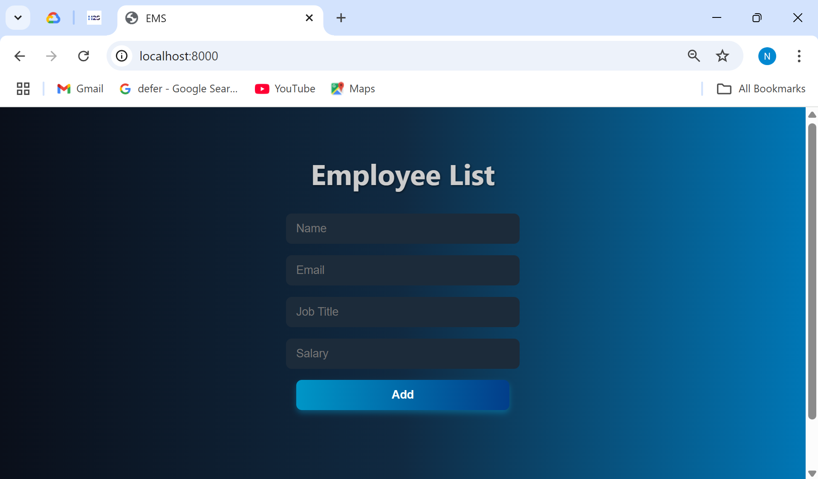
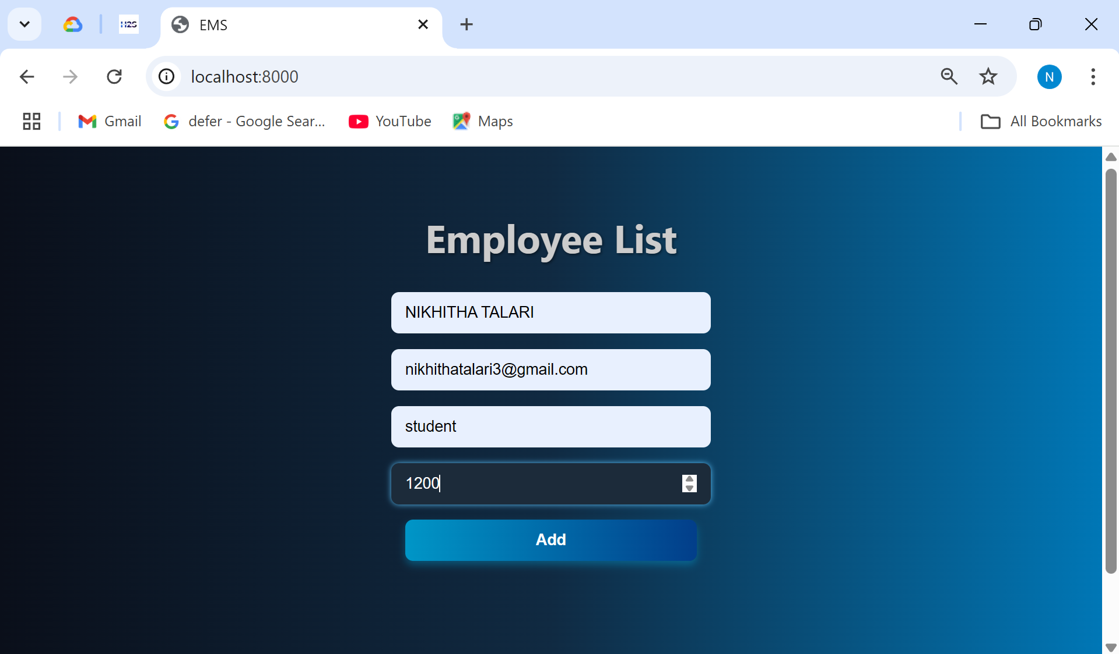
OUTPUTS
Entering the data

Slide 11
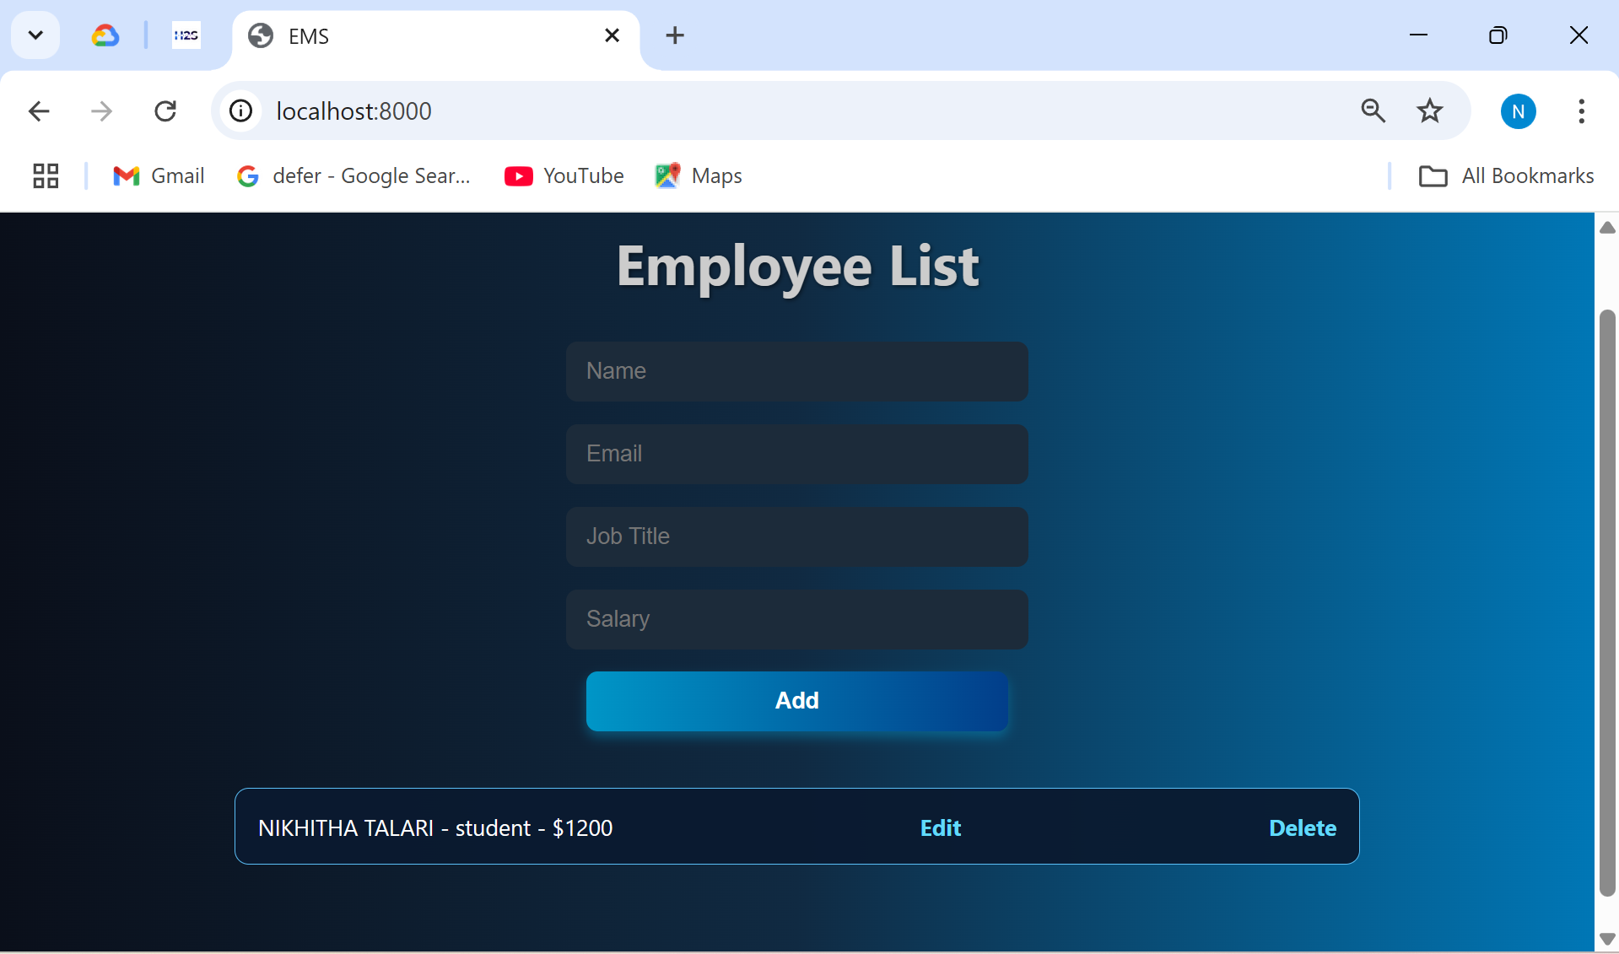
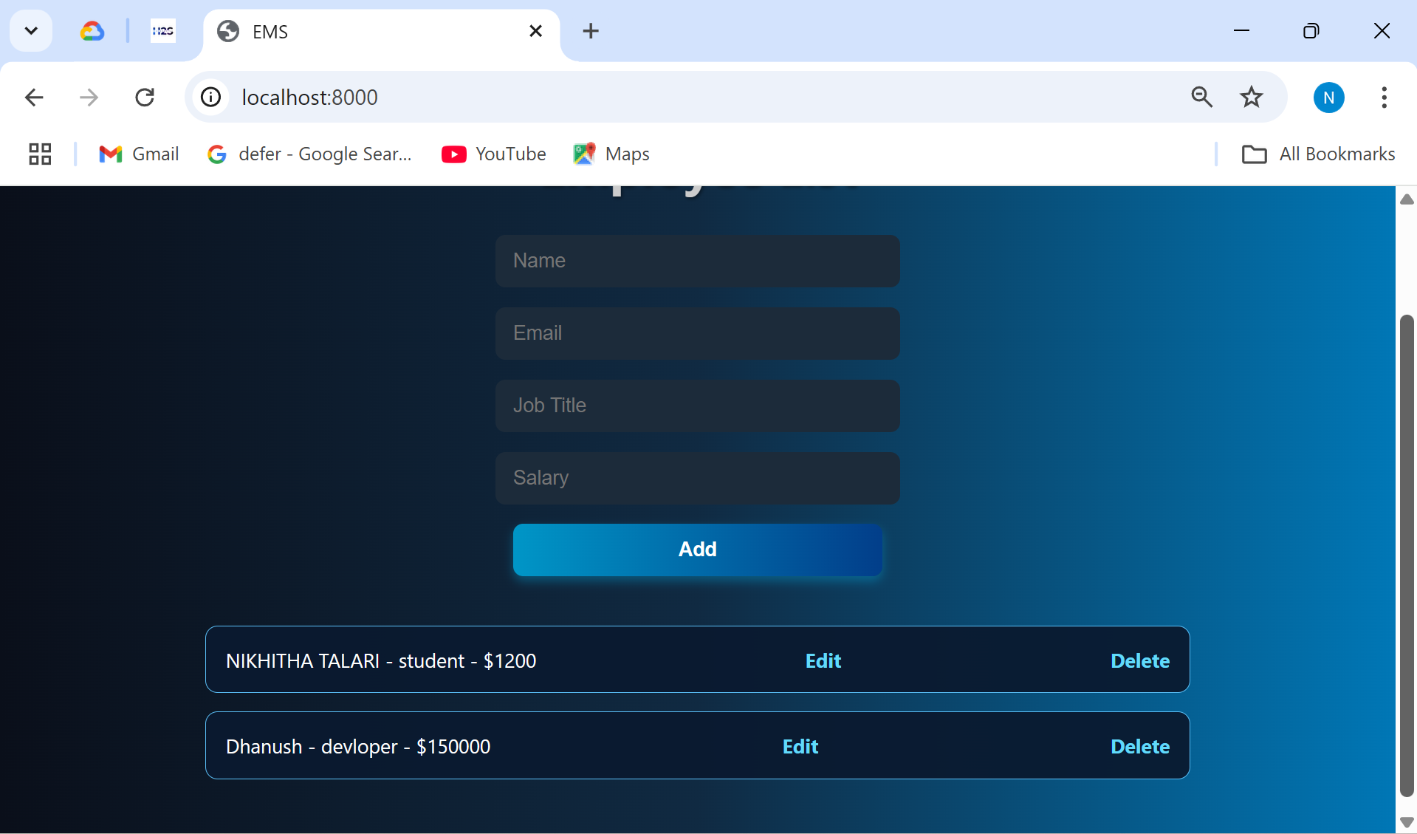
OUTPUTS

Slide 12
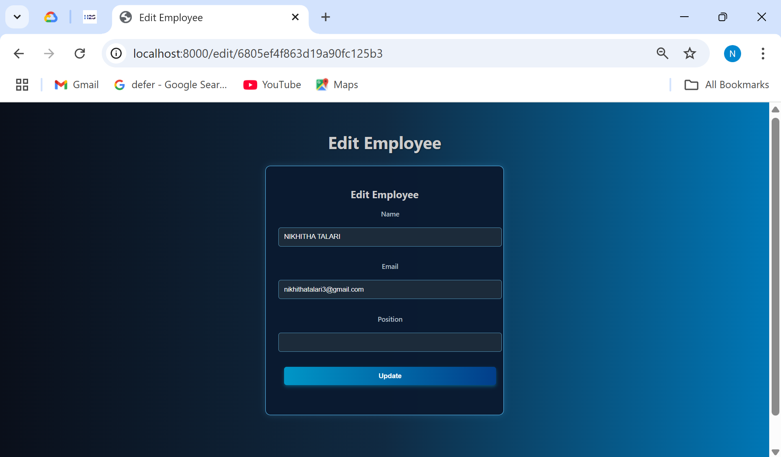
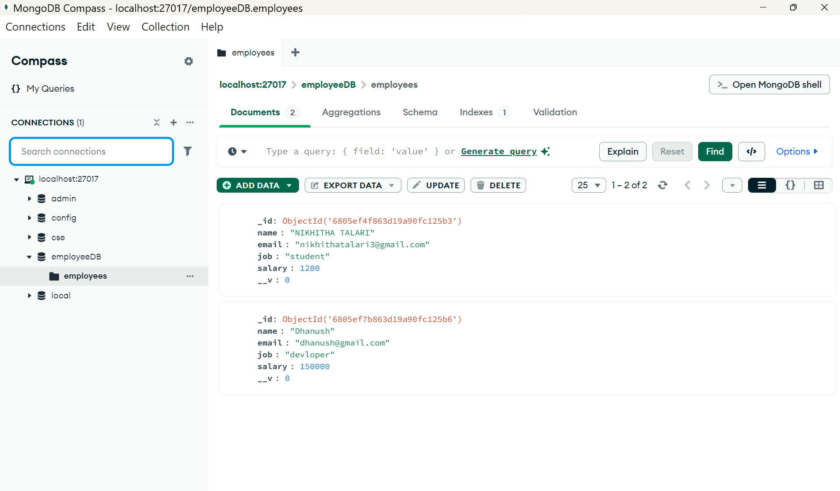
OUTPUTS
Mongo db

Slide 13

References
ADP Employee Management
GeeksforGeeks EMS Program
3. GeeksforGeeks Node.js EMS

Slide 14

Thank You

